Slide 1
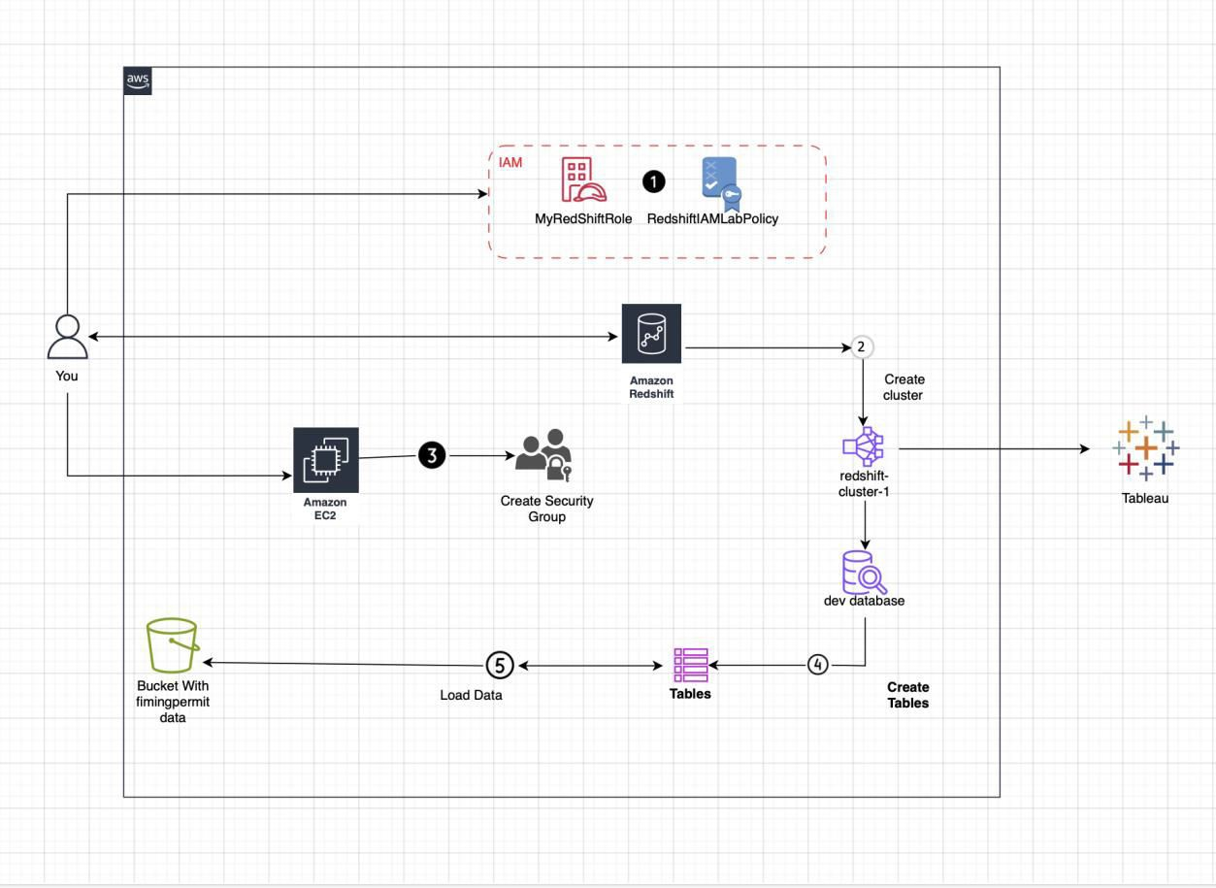
NIT 2202 (BIG DATA)
Rites Luitel (s4682841) Assessment PART I (Project 1)
AWS Architecture

Slide 2
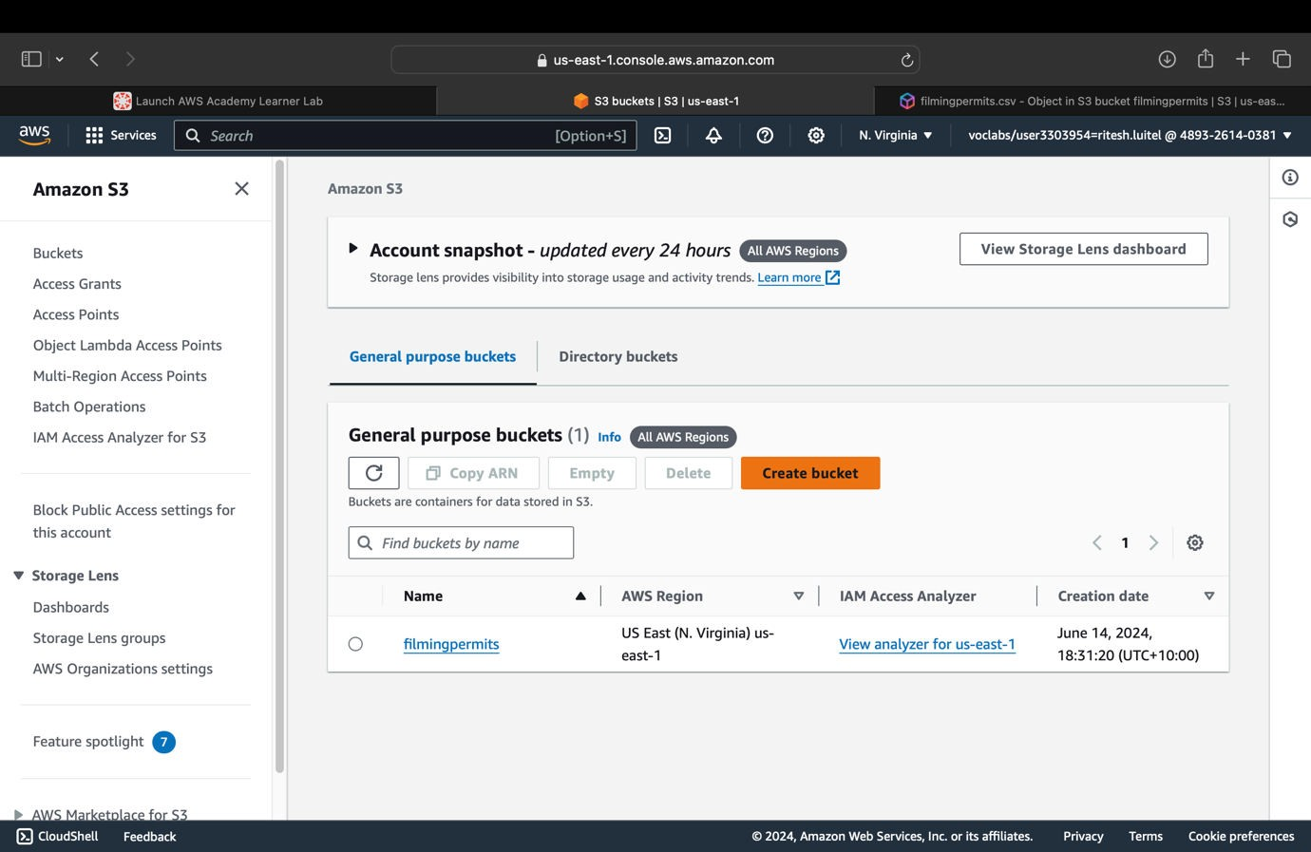
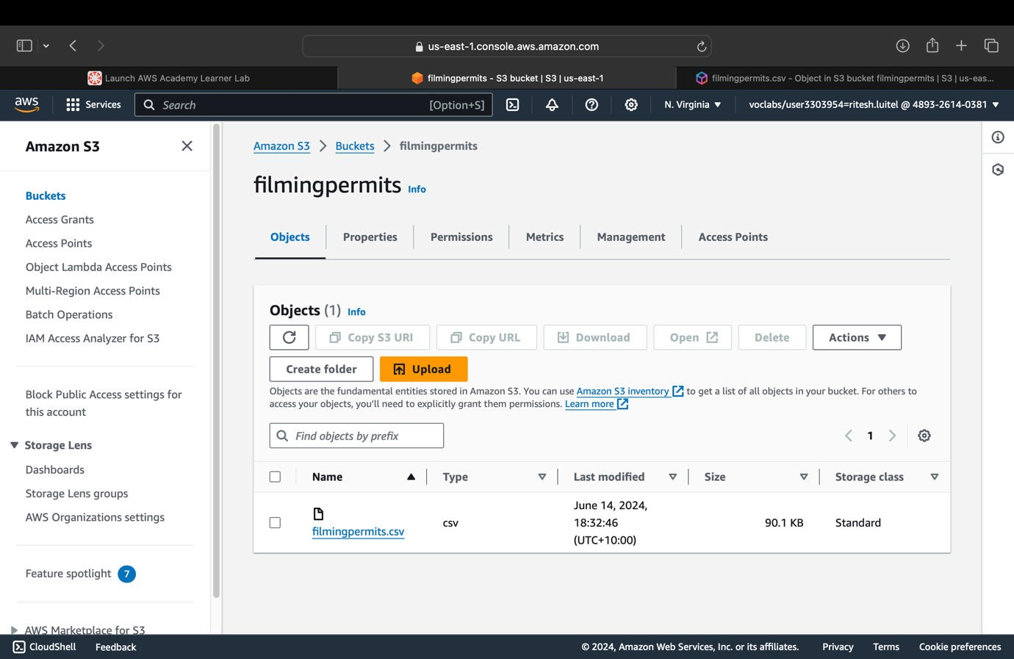
1. Creating S3 bucket with name (filmingpermits):
2. Uploaded the project data (CSV file) in S3 bucket:

Slide 3
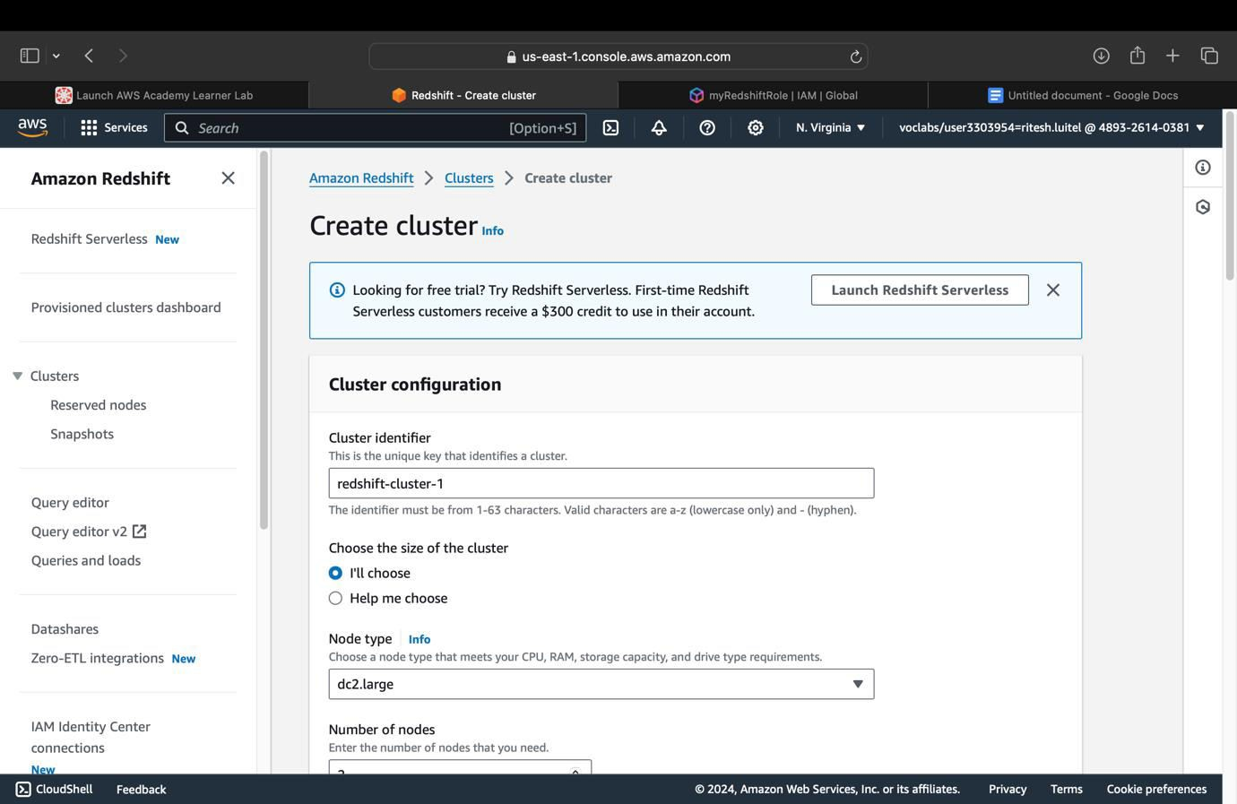
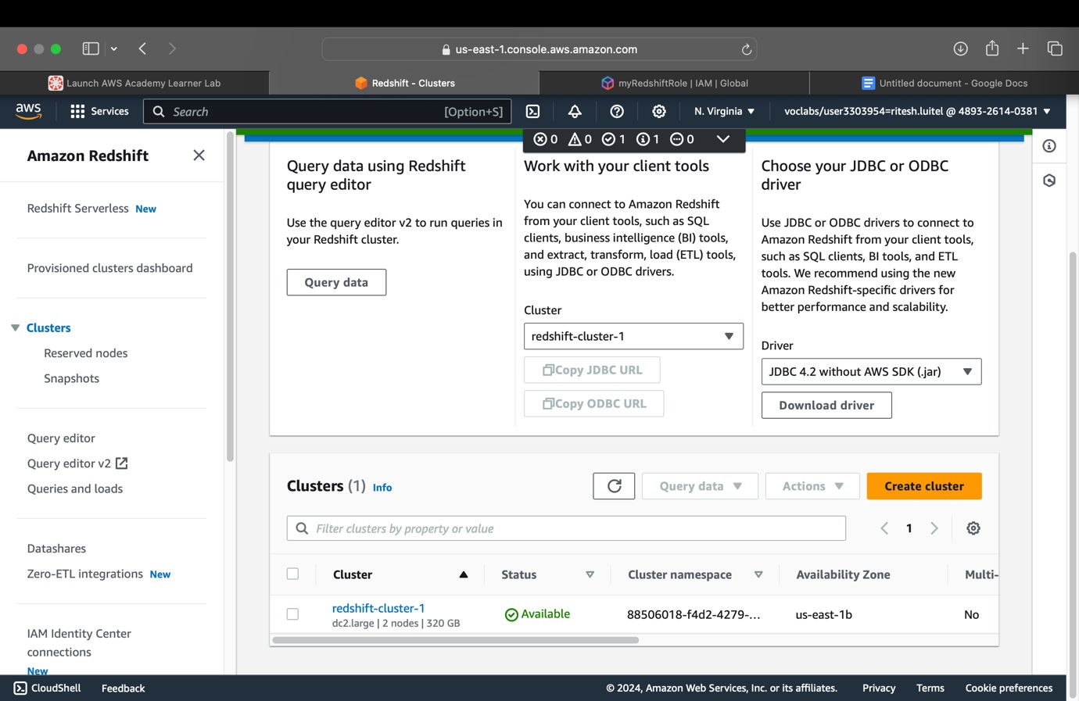
3. Creating Redshift cluster (redshift-cluster-1) (with nodes = 2, node type = dc2.large, password
= Passw0rd1, and “myredshiftrole” as associated IAM roles)
Fig: redshift-cluster-1 created & available

Slide 4
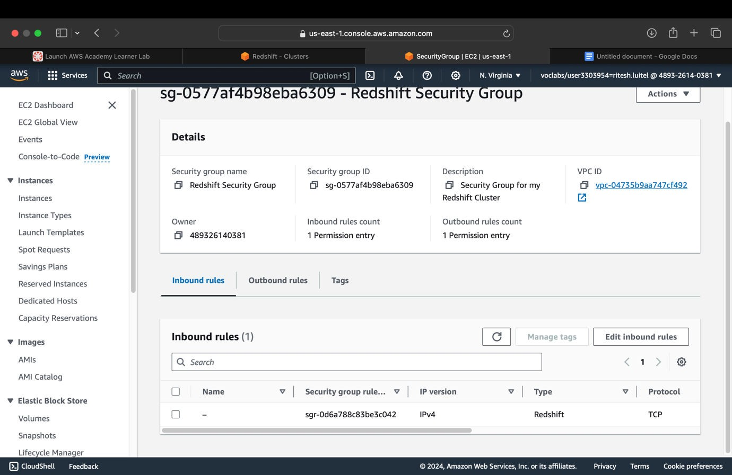
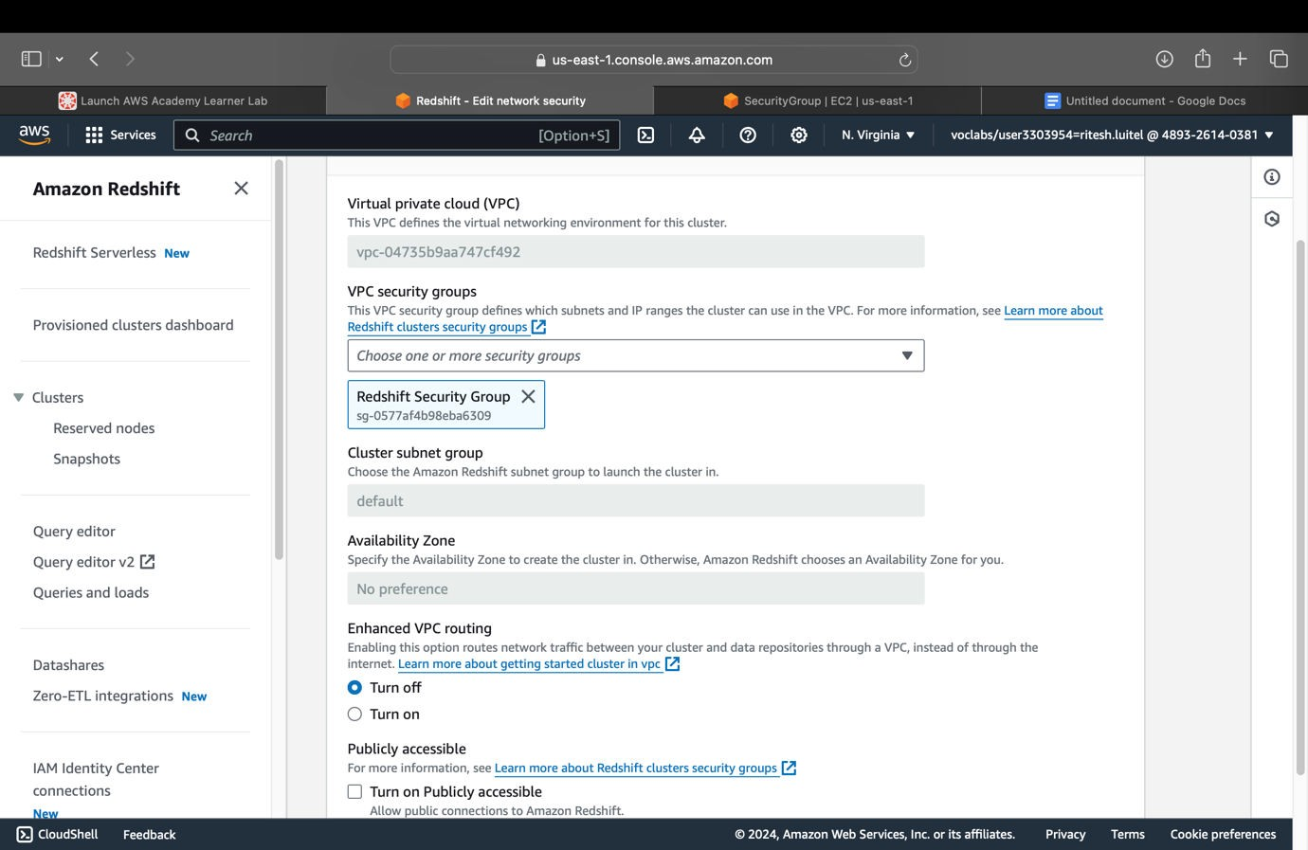
4. Creating security group with the settings (Type - Redshift, and Source - IPv4):
5. Editing security settings for redshift cluster (Choosing Redshift Security Group and clearing the default):

Slide 5
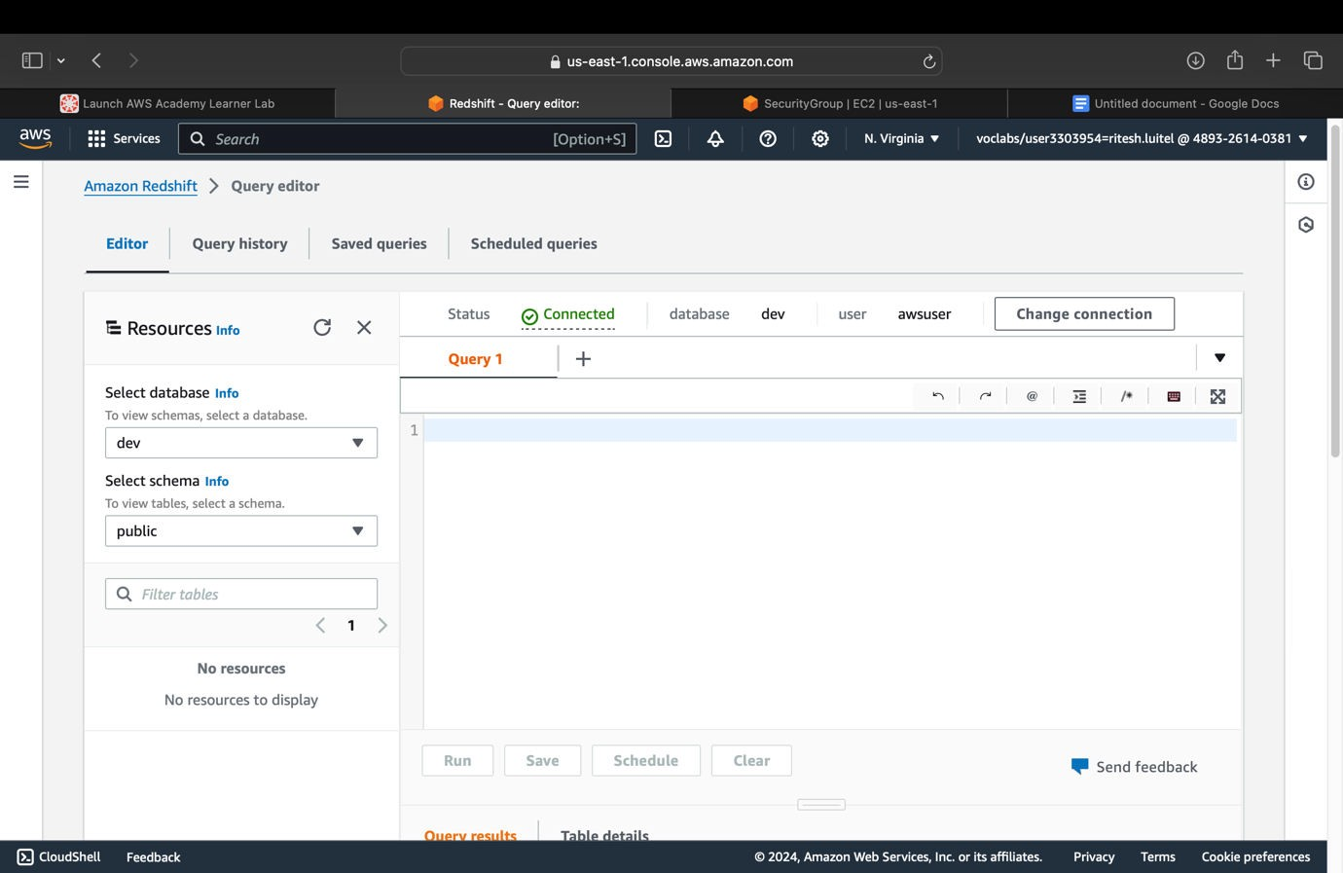
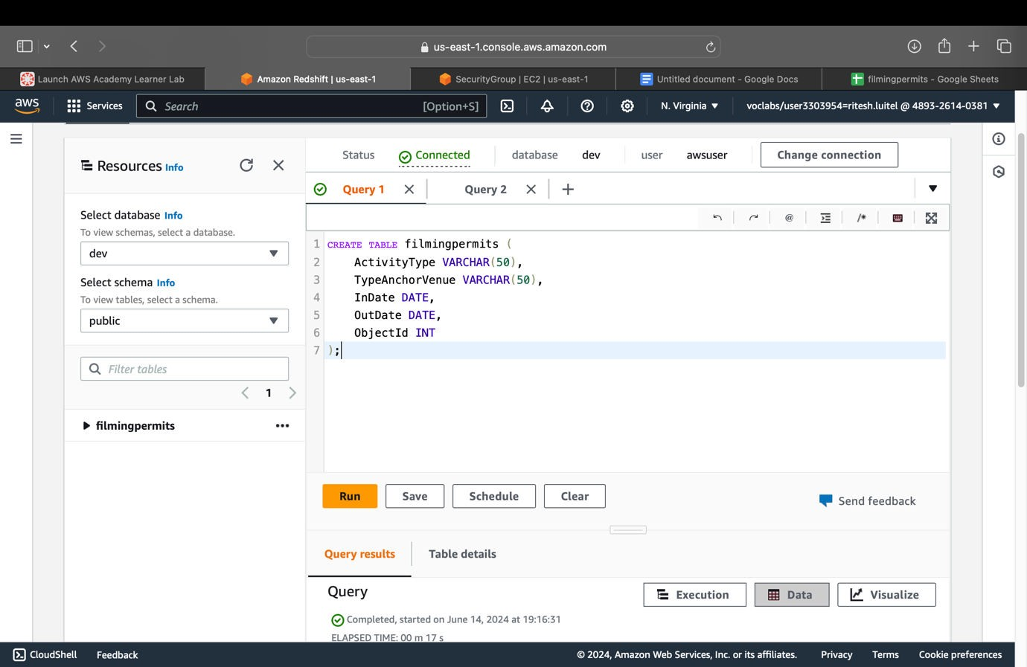
6. Connecting with dev database (Database Name - ‘dev’ & Database User - ‘awsuser’)
7. Creating a table with SQL that matches exactly with project file in Redshift Cluster:

Slide 6
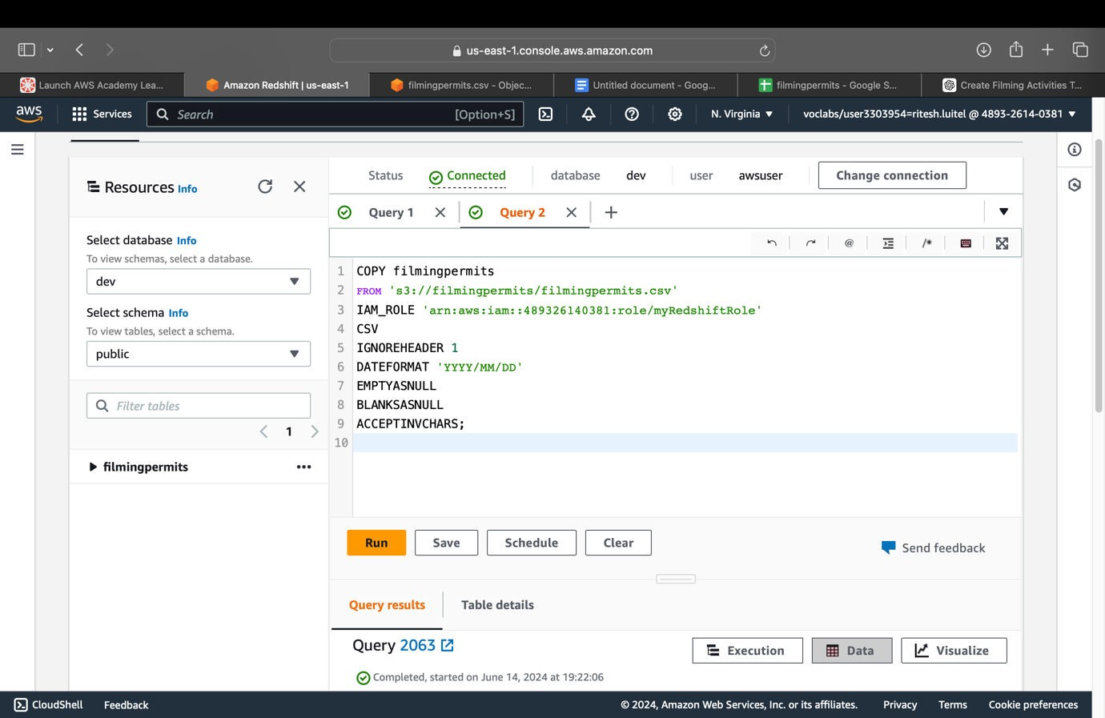
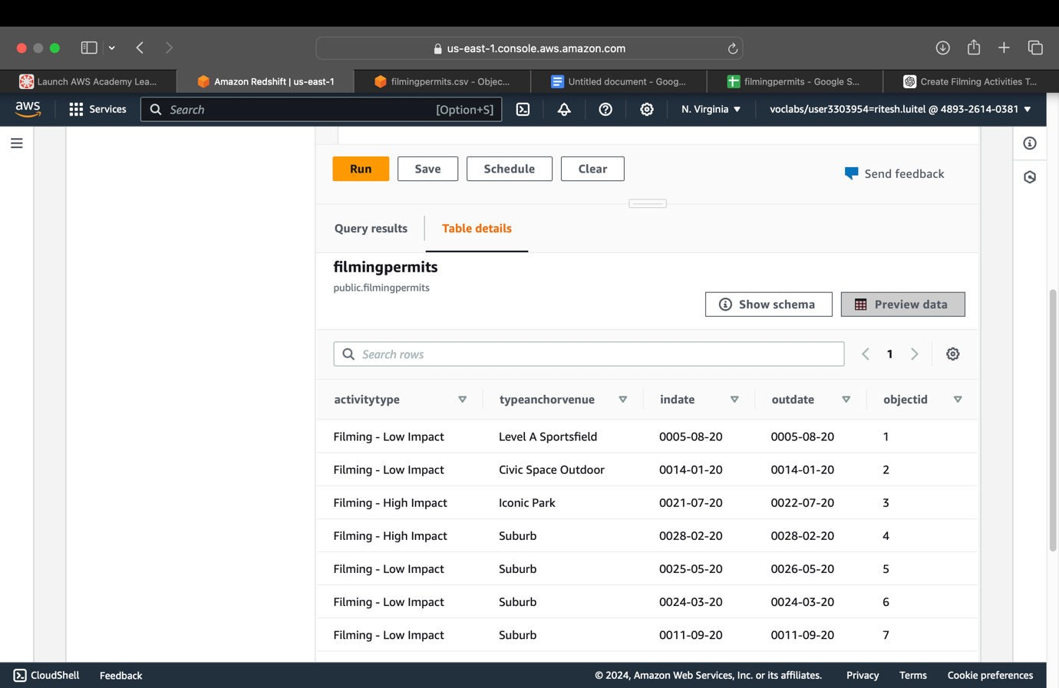
8. Loading the project data from S3 in redshift cluster:
(S3 URL copied from bucket ‘filmingpermits’ & ARN copied from myRedshiftRole in EC2)
9. Previewing the data of that table in redshift:
Fig: Results after ‘Preview Data’

Slide 7
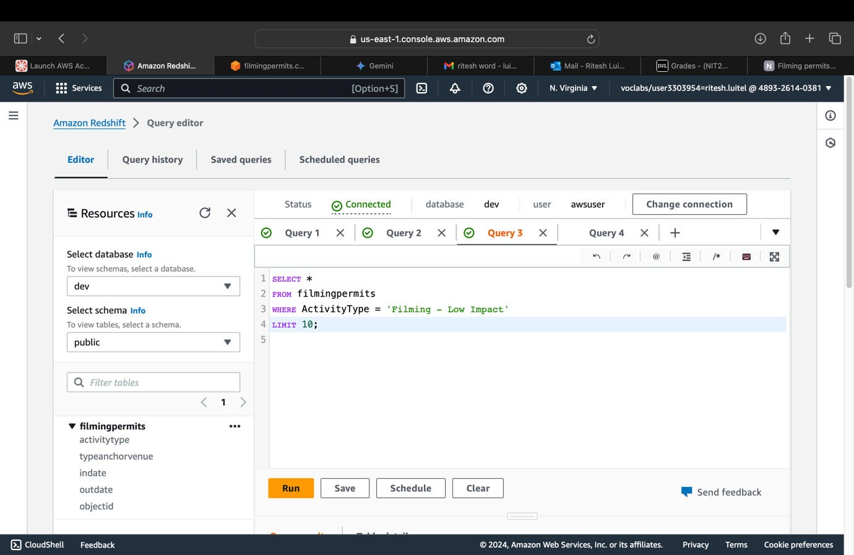
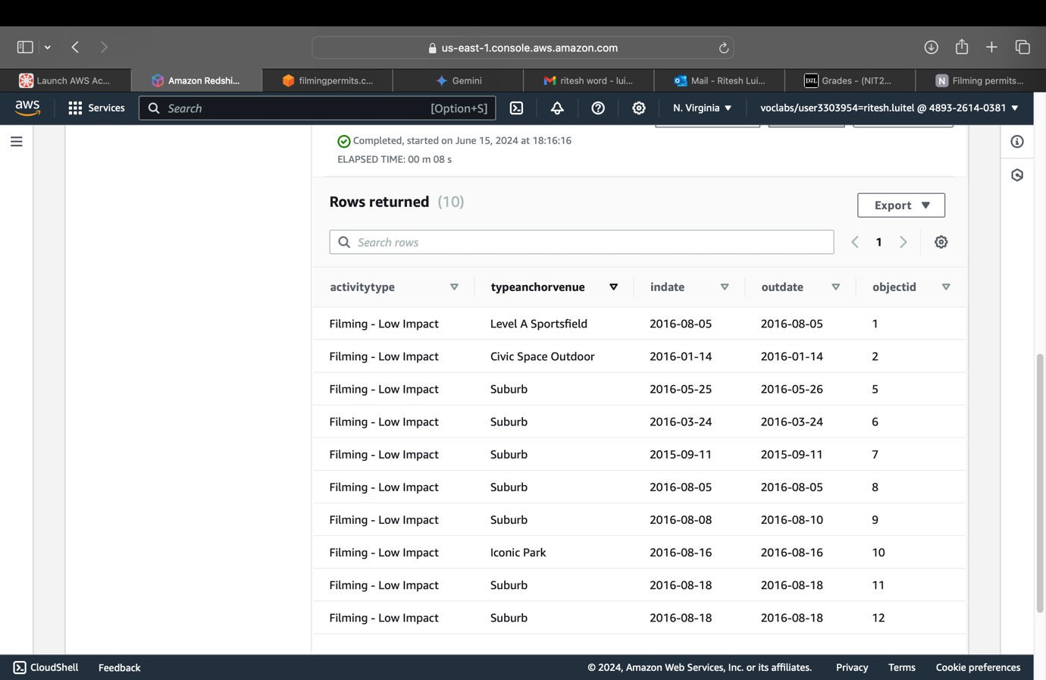
10. Running Four queries:
- Two simple queries:
Query 1: Retrieve all rows for a specific Activity Type
Fig: Results for Query 1

Slide 8
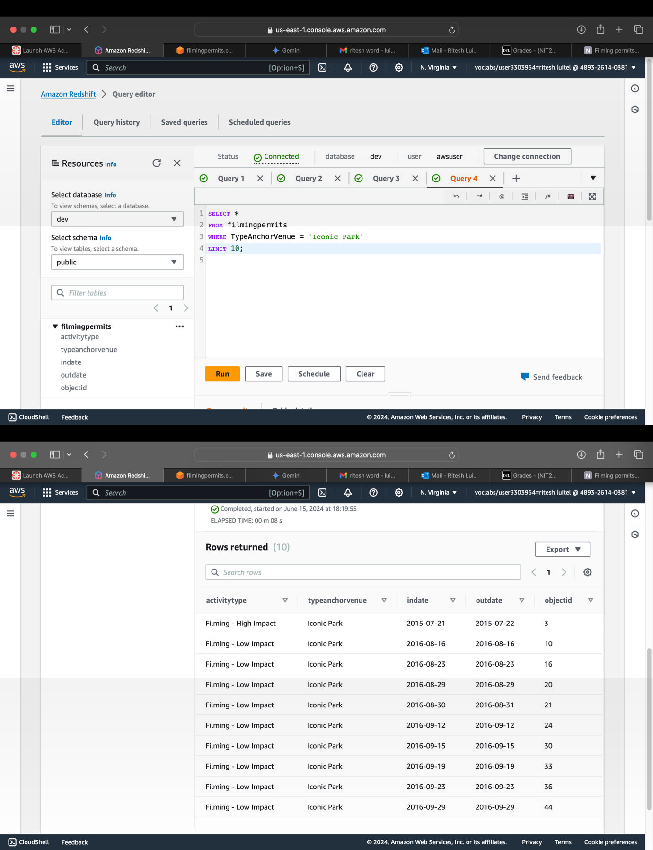
Query 2: Retrieve rows where the event took place at a specific venue
Fig: Results for Query 2

Slide 9
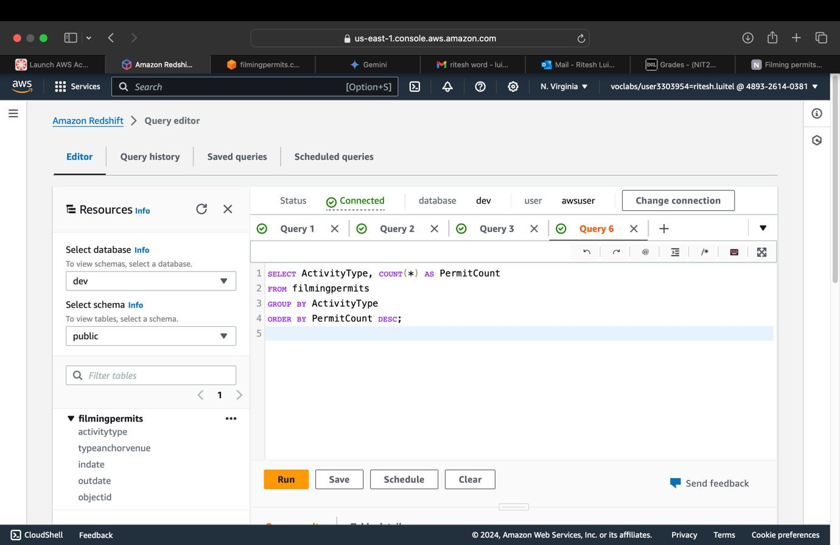
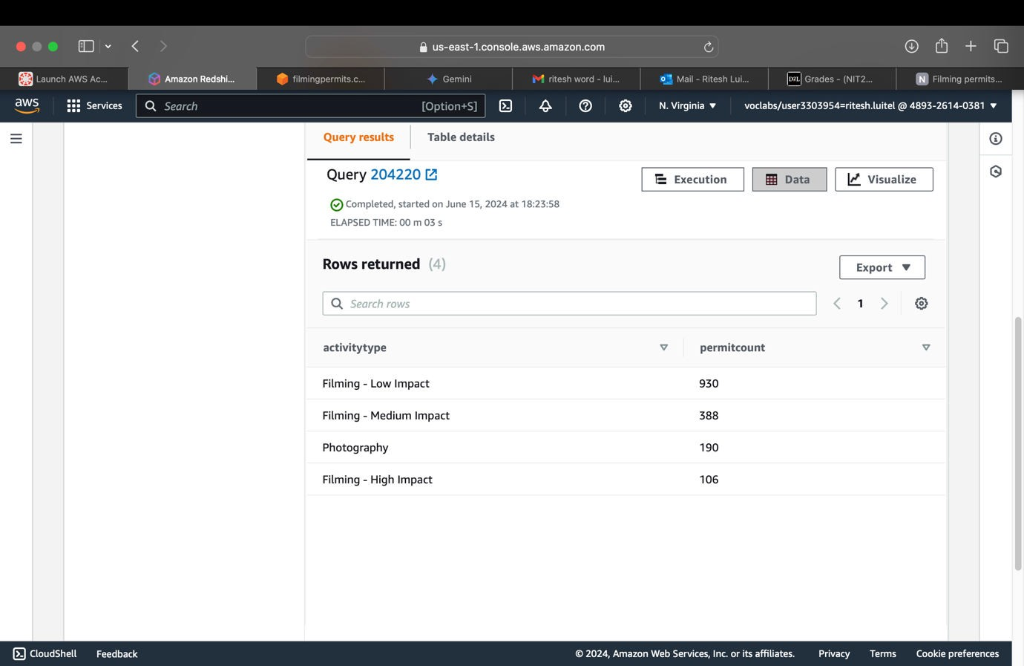
Two Complex queries:
Query 3: Count the number of permits for each ActivityType
Fig: Results for Query 3

Slide 10
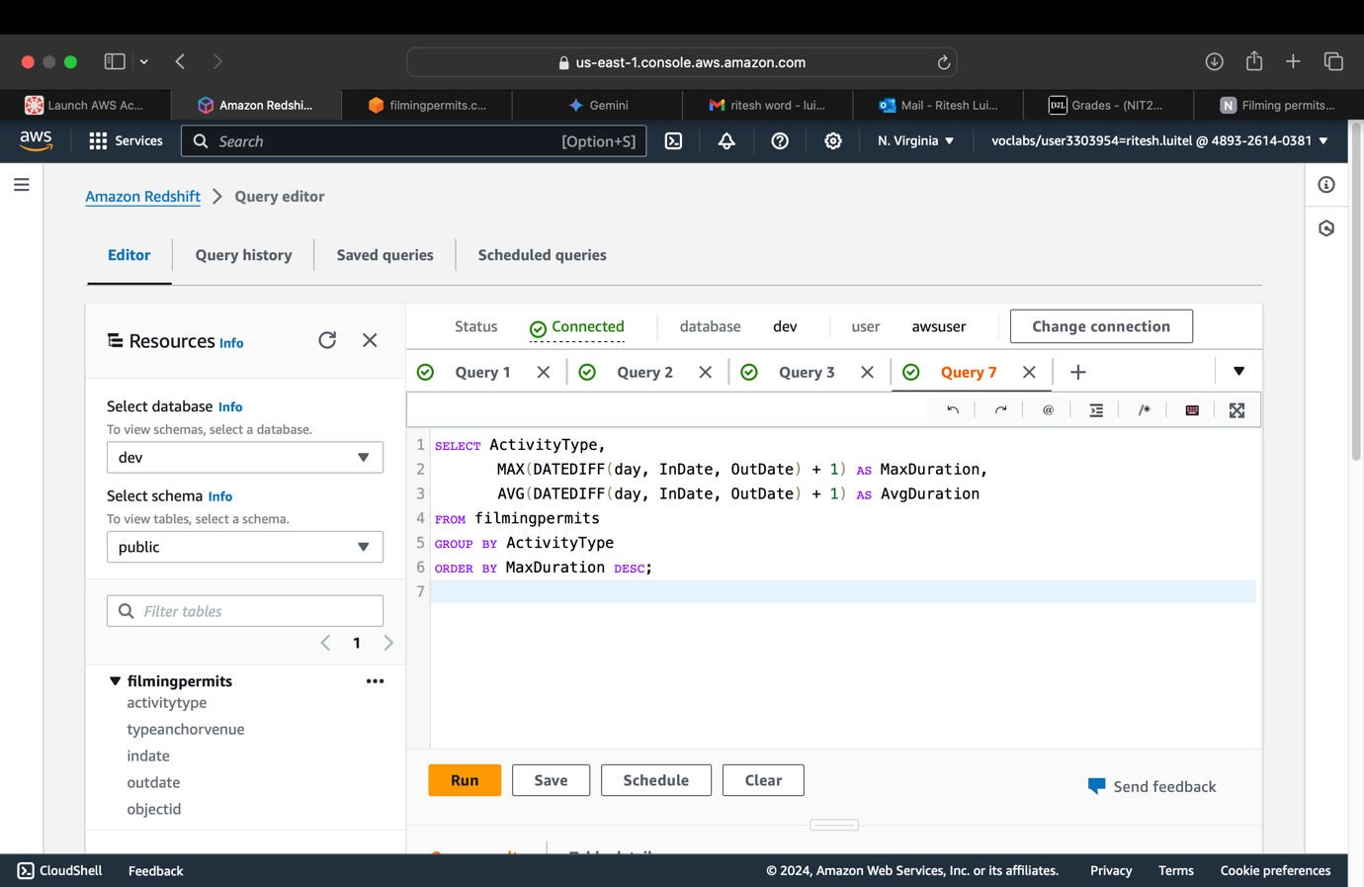
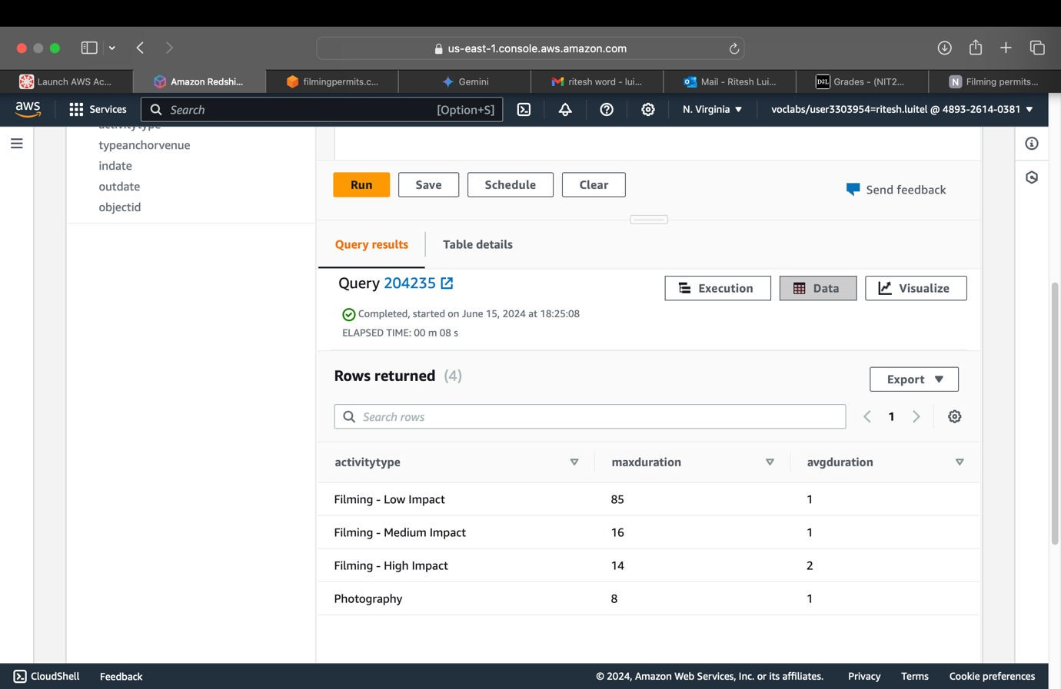
Query 4: Find the maximum and average duration of filming permits grouped by ActivityType

Slide 11
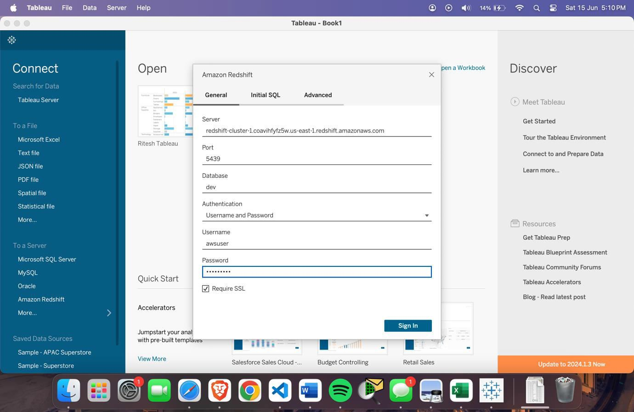
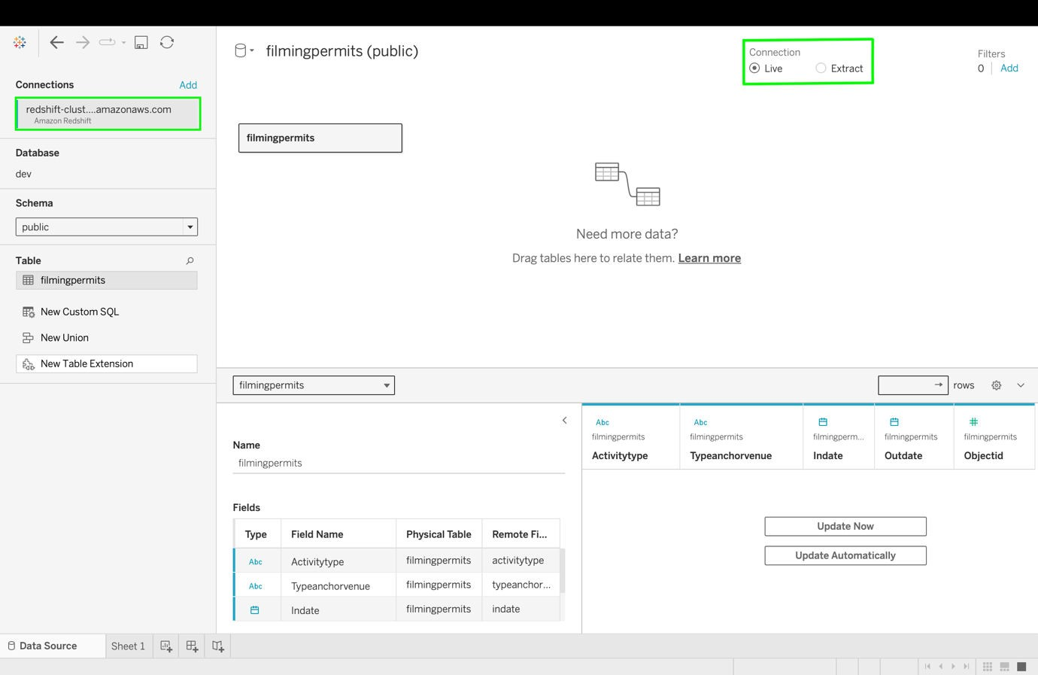
11. Connecting Tableau with Amazon Redshift:
12. Tableau – Live Data Connection and Live Data Synchronization

Slide 12
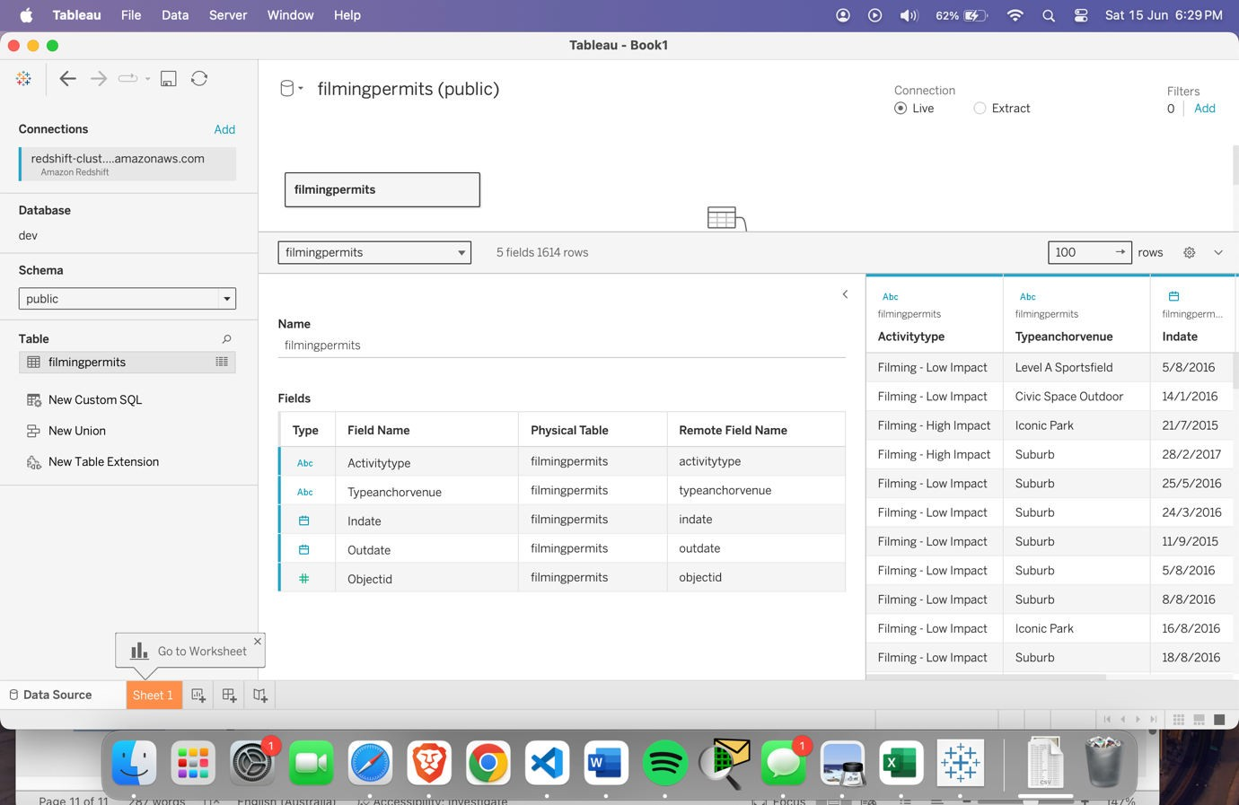
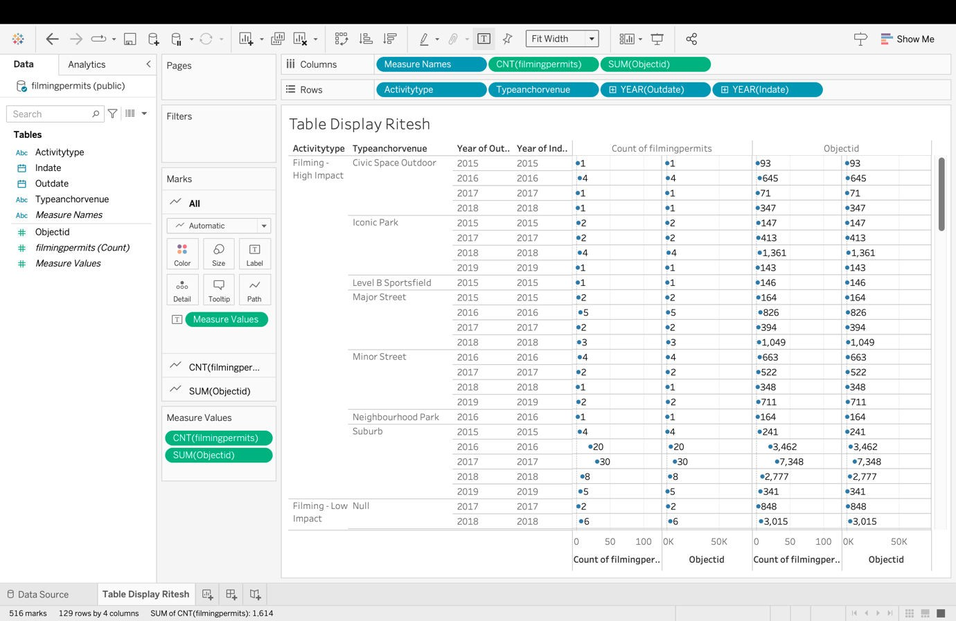
14. Tableau - Table Display

Slide 13
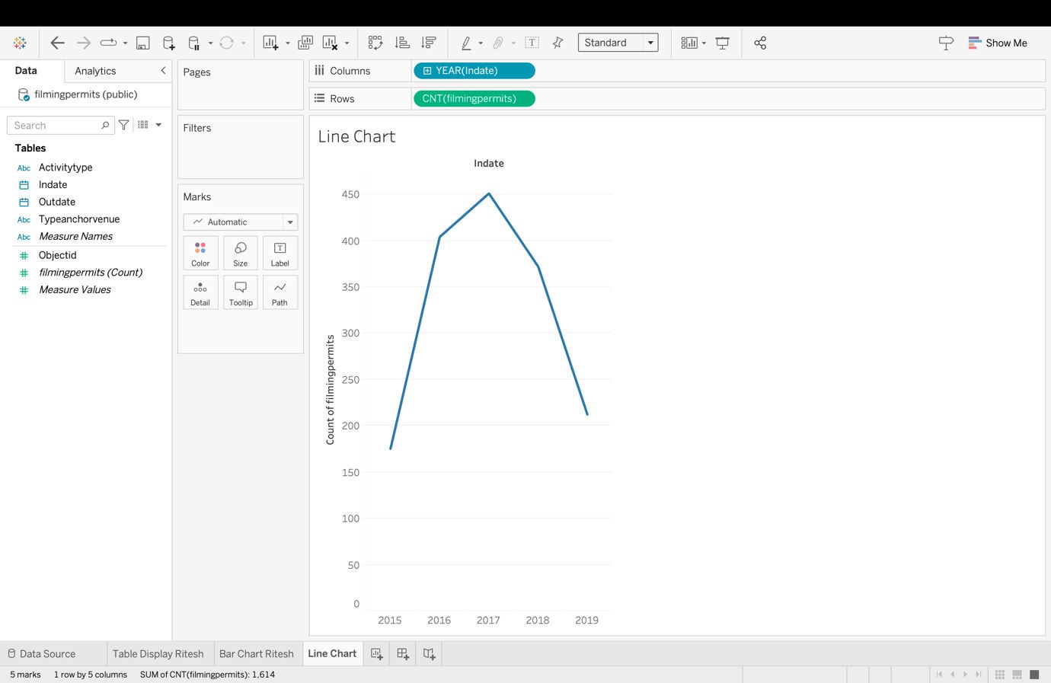
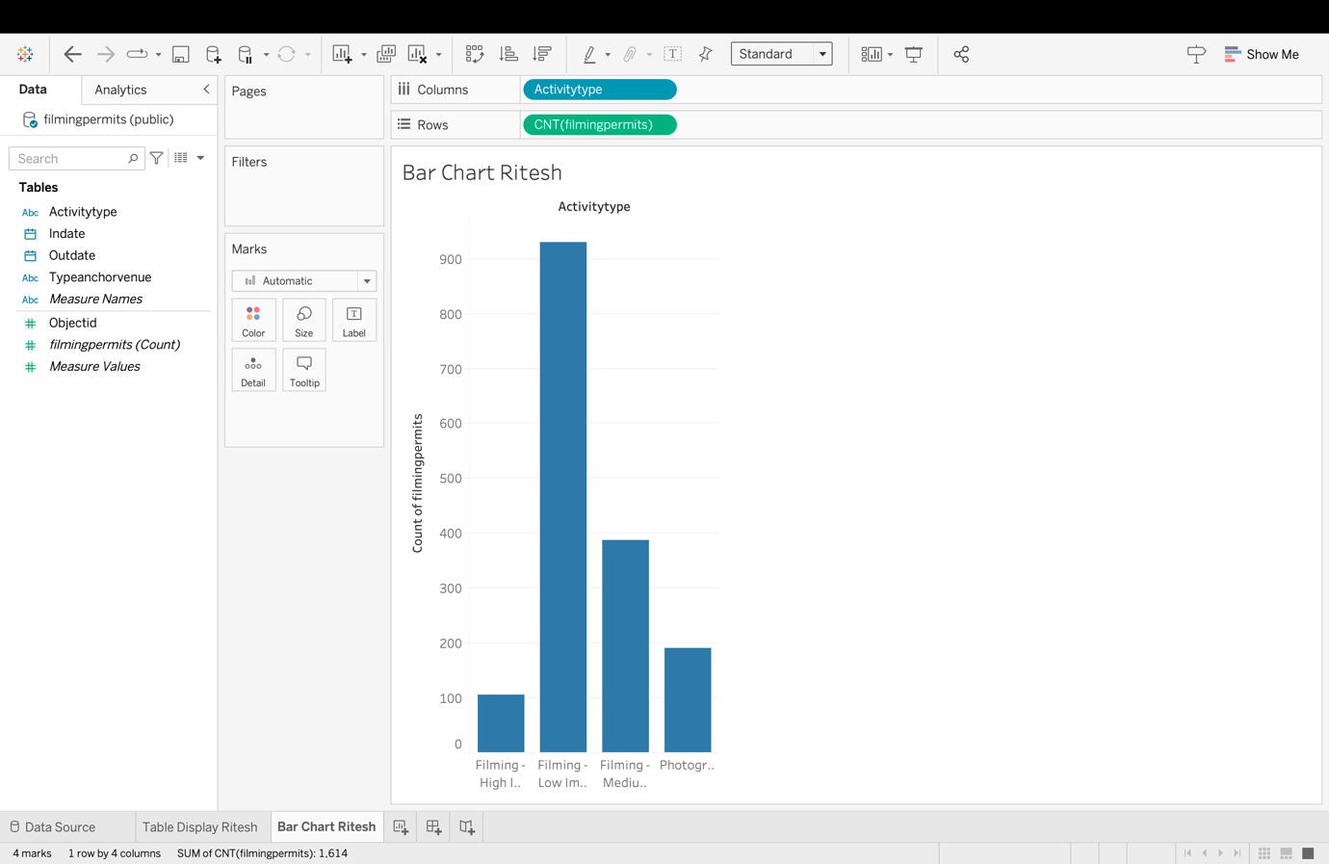
15. Creating three charts/graphs PLUS a Dashboard in Tableau.
Line Chart
Bar Chart

Slide 14
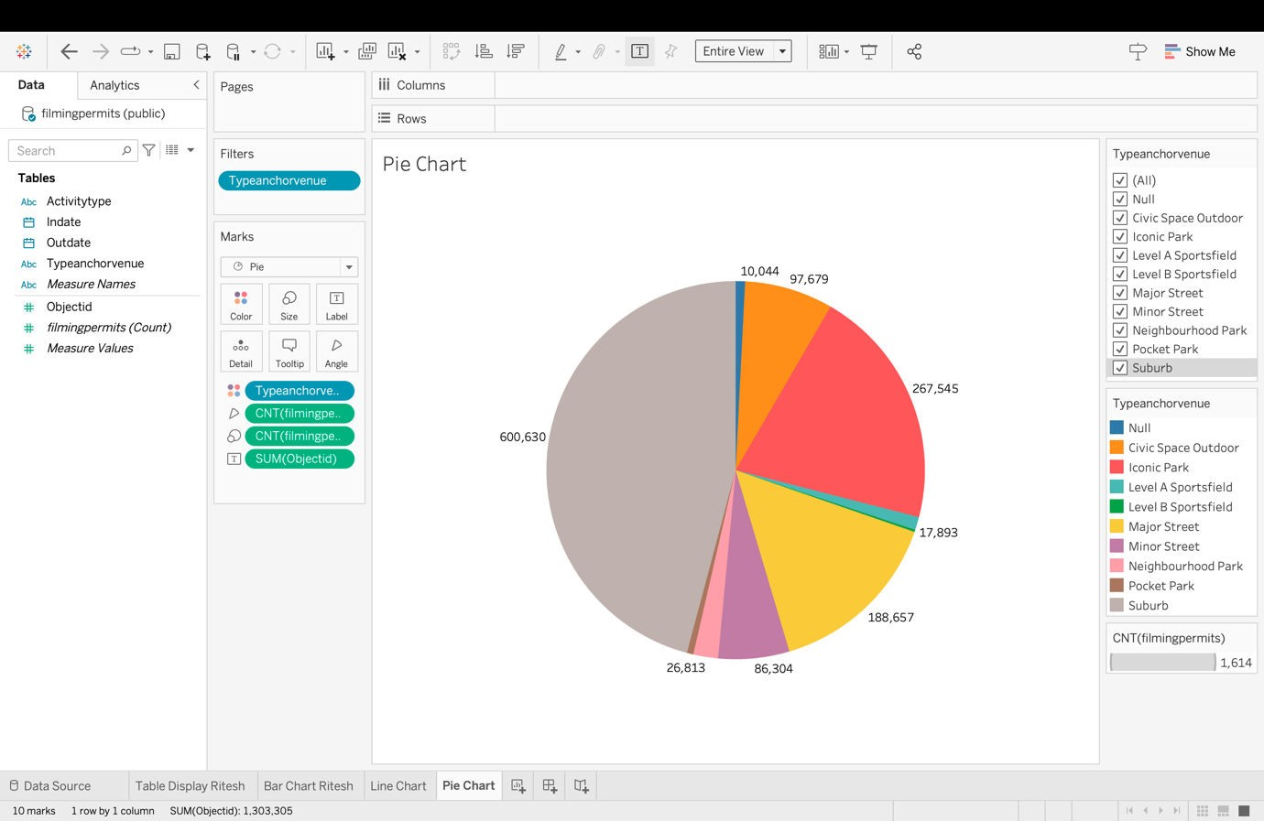
Pie Chart

Slide 15
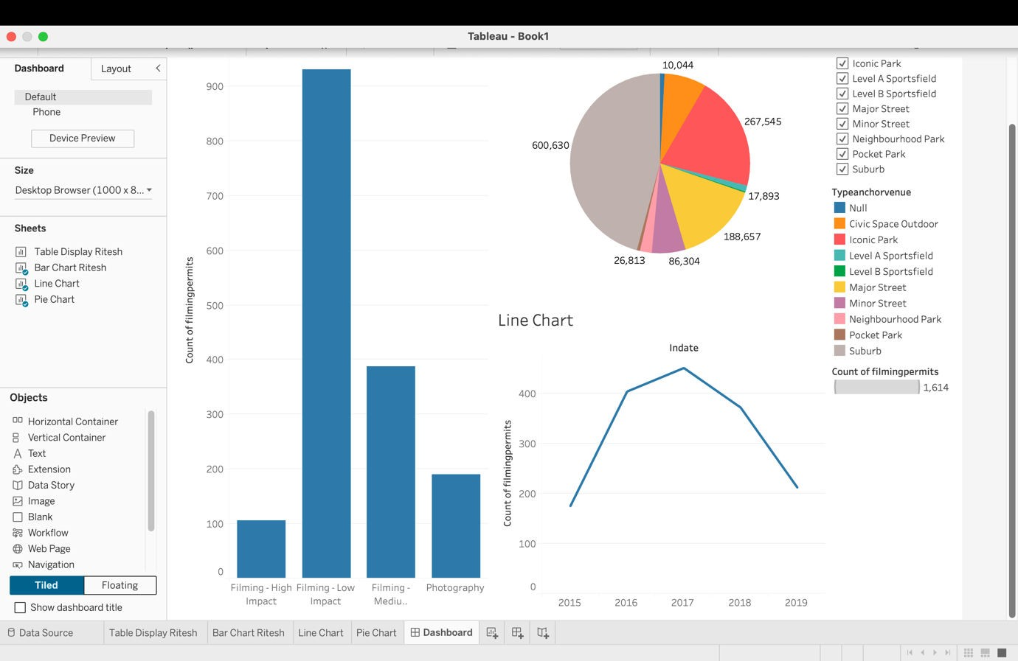
- Data Visualization 2 – Dashboard
16. AWS Details: Project Hours/Cost
Task Description | Date | Hours Spent | Notes
Creating S3 bucket & uploading the file | 2024- 06-14 | 15 minutes | Created S3 bucket and uploaded project CSV file.
Setting up Amazon Redshift and | 2024- | 15 | Set up Amazon Redshift and
configuring security group | 06-14 | minutes | configured security group for secure
 |  |  | access.
Connecting Redshift cluster to | 2024- | 20 | Connected Redshift cluster to
the database and creating a | 06-14 | minutes | database and created table using
table using SQL |  |  | SQL.
Loading data into Amazon | 2024- | 40 | Uploaded CSV data files to Redshift
Redshift | 06-14 | minutes | for analysis.
Executing SQL queries | 2024- 06-15 | 0.5 hours | Ran SQL queries to validate data and do preliminary analysis
Connecting Tableau to Amazon | 2024- | 0.5 hours | Set up live data connection between
Redshift and installing ODBC | 06-15 |  | Tableau and Redshift by installing
driver) |  |  | ODBC driver.
Creating visualizations in | 2024- | 1 hour | Made charts and dashboards in
Tableau | 06-15 |  | Tableau to show data insights.
Architecting AWS infrastructure | 2024- 06-16 | 1.5 hour | Planned AWS architecture for the project, detailing roles and interactions of components.
Reviewing project | 2024- | 1 hour | Reviewed and updated project
documentation | 06-16 |  | documentation for completeness

Slide 16
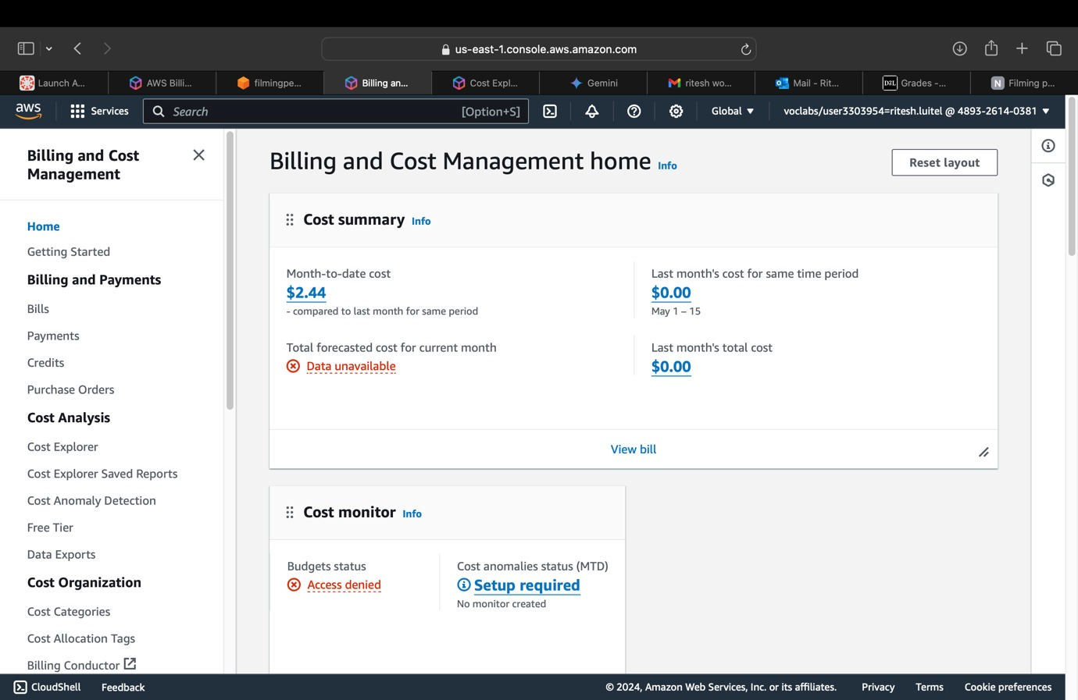
and accuracy.
Cost incurred:
Queries Performed:
Simple and Complex Queries
1.Retrieve all rows for a specific ActivityType
SELECT *
FROM filmingpermits
WHERE ActivityType = 'Filming - Low Impact' LIMIT 10;
2. Retrieve rows where the event took place at a specific venue
SELECT *
FROM filmingpermits

Slide 17
WHERE TypeAnchorVenue = 'Iconic Park' LIMIT 10;
3. Count the number of permits for each ActivityType
SELECT ActivityType, COUNT(*) AS PermitCount FROM filmingpermits
GROUP BY ActivityType
ORDER BY PermitCount DESC;
4. Find the maximum and average duration of filming permits grouped by ActivityType
SELECT ActivityType,
MAX(DATEDIFF(day, InDate, OutDate) + 1) AS MaxDuration, AVG(DATEDIFF(day, InDate, OutDate) + 1) AS AvgDuration
FROM filmingpermits GROUP BY ActivityType
ORDER BY MaxDuration DESC;

